Slide 1
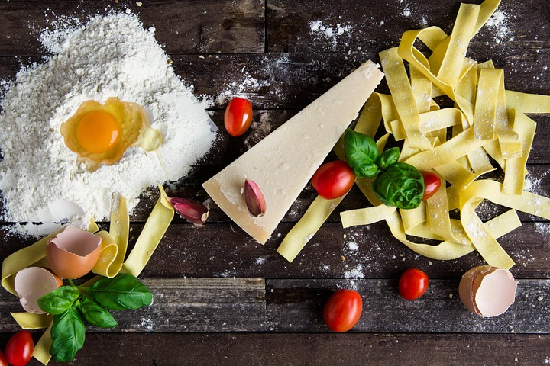
All the recipes: Scraping the top 20 recipes of Allrecipes for the last 20 years
Yannick Kimmel

Slide 2
Introduction
Allrecipes is the most popular recipe website (eBzMBA)
Website has been around since 1997 (ancient)
Is not known for ‘foodie’ recipes but for go to for the average American.
Every year, allrecipes releases the top 20 recipes of the year.
Motivation: Use the top 20 list as representation of food trends, and gain insights.

Slide 3
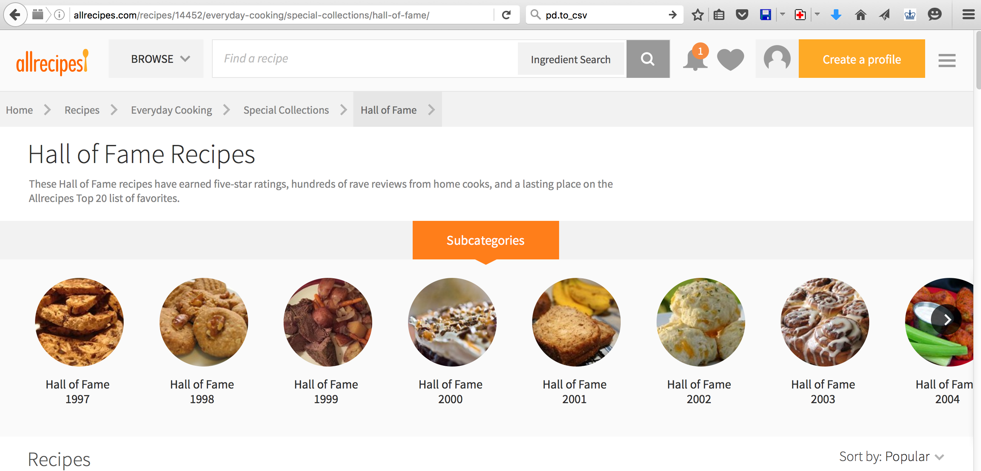
Hall of fame recipes

Slide 4
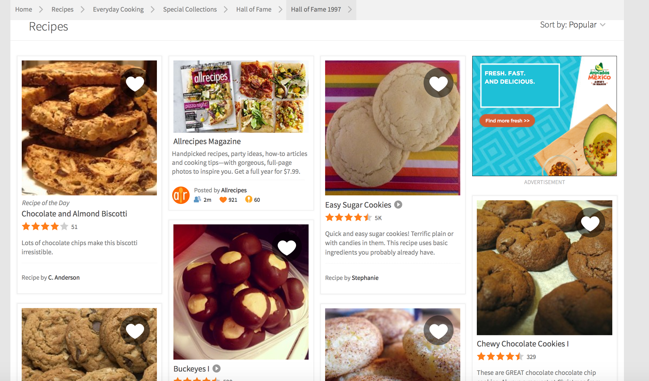
Hall of fame 1997
urls = html_list.find_elements(By.CLASS_NAME, "favorite")
for i, e in enumerate(urls):
id.append(e.get_attribute('data-id'))
urls[i] = 'https://allrecipes.com/recipe/' + str(id[i])

Slide 5
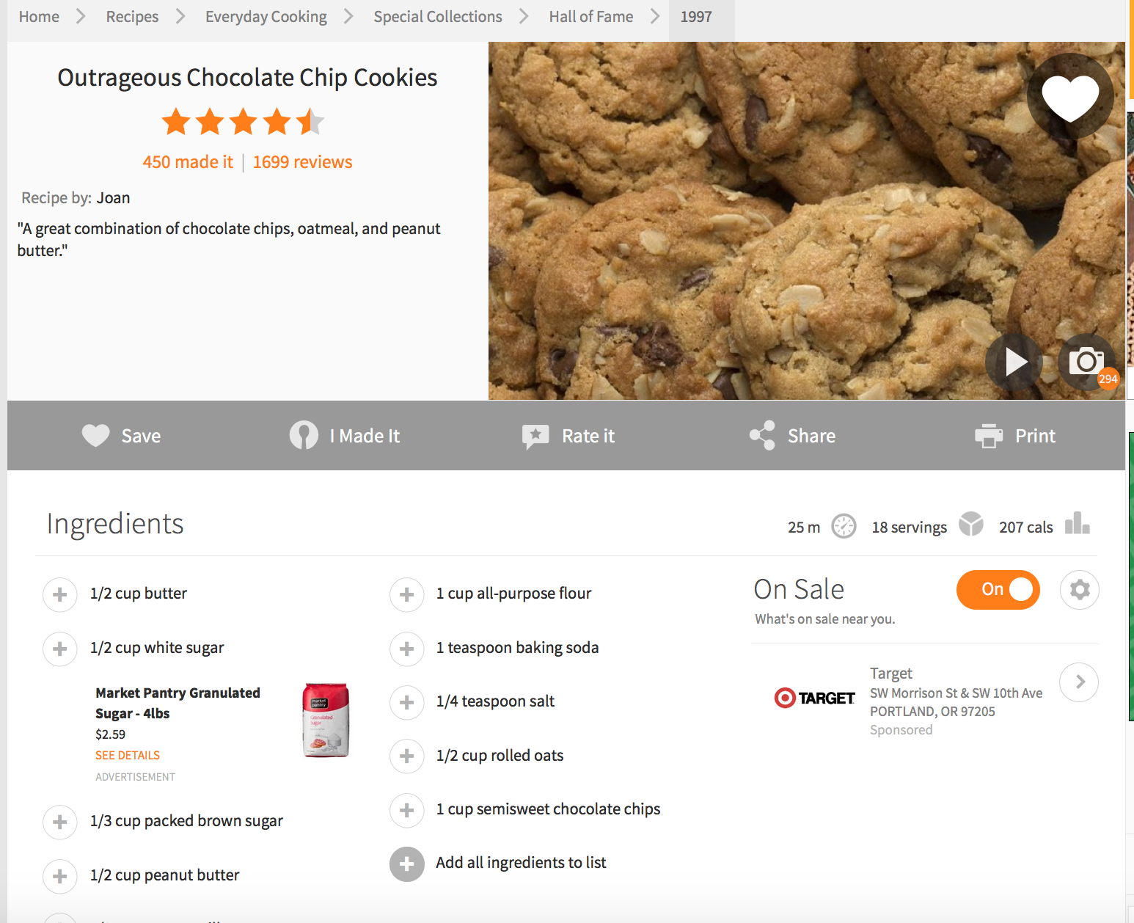
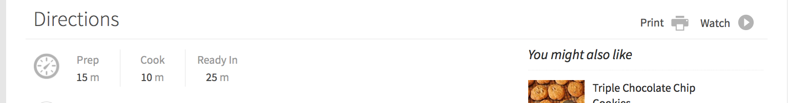
Example recipe

Slide 6
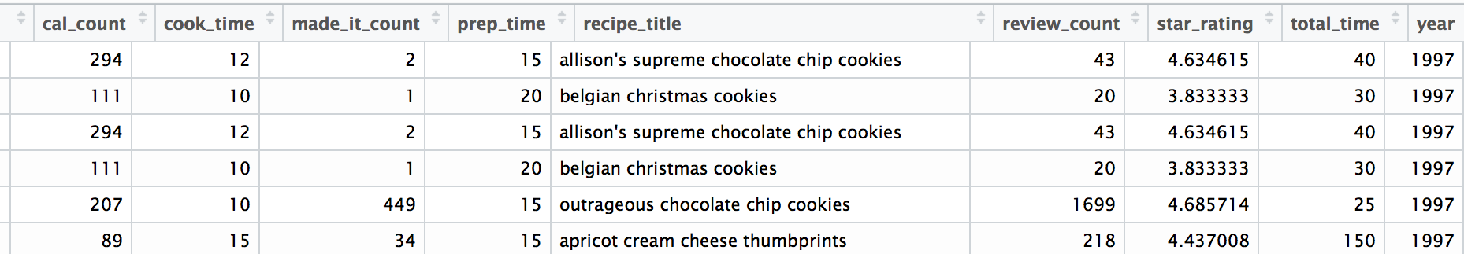
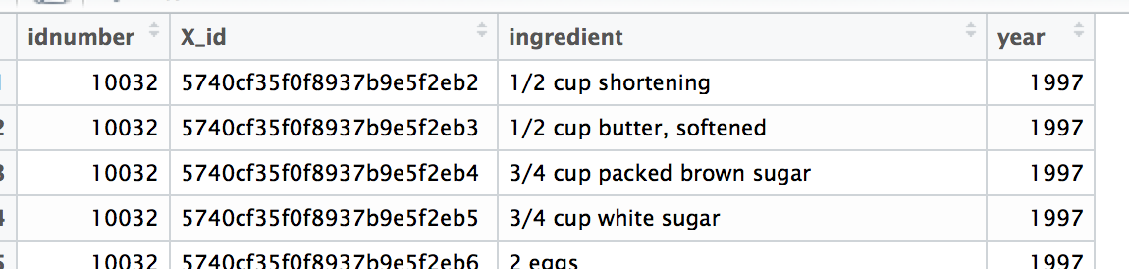
Scraped using Python (Selenium), cleaned data through iPython and stored in MongoDB
Recipes
Ingredients

Slide 7
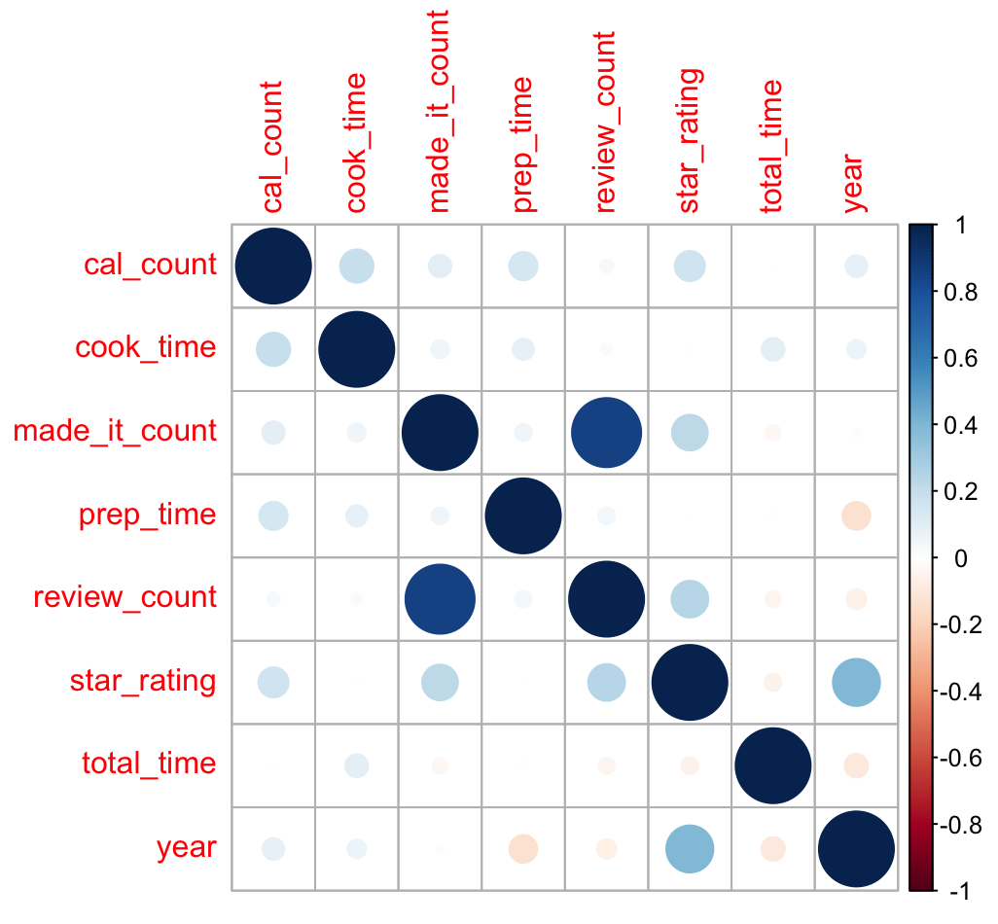
Correlation among recipe variables
For most part, variables do not correlate well, indicating a well designed website.
Difficult for data analysis.

Slide 8
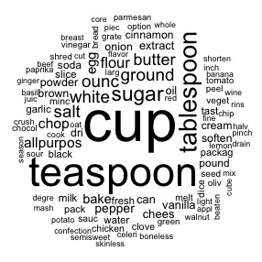
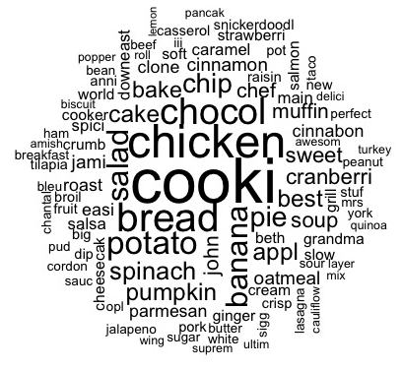
Word clouds
Recipes
Ingredients
R packages: wordcloud and tm

Slide 9
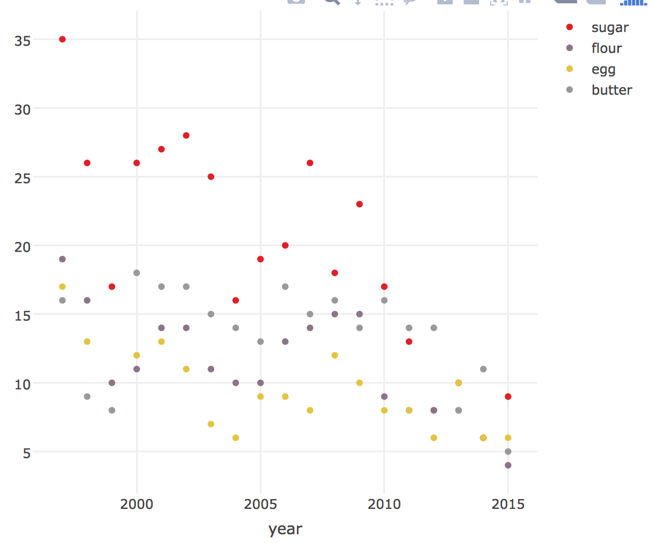
Declining frequency of baked goods ingredients

Slide 10
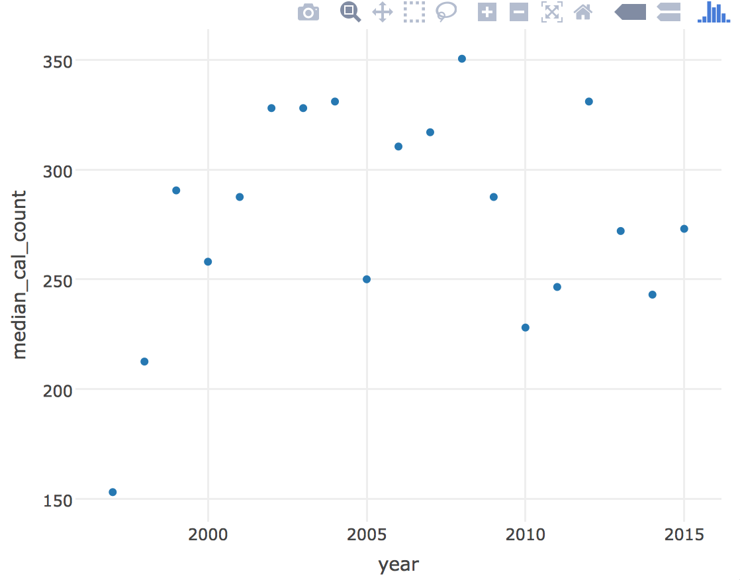
Median calories per serving

Slide 11
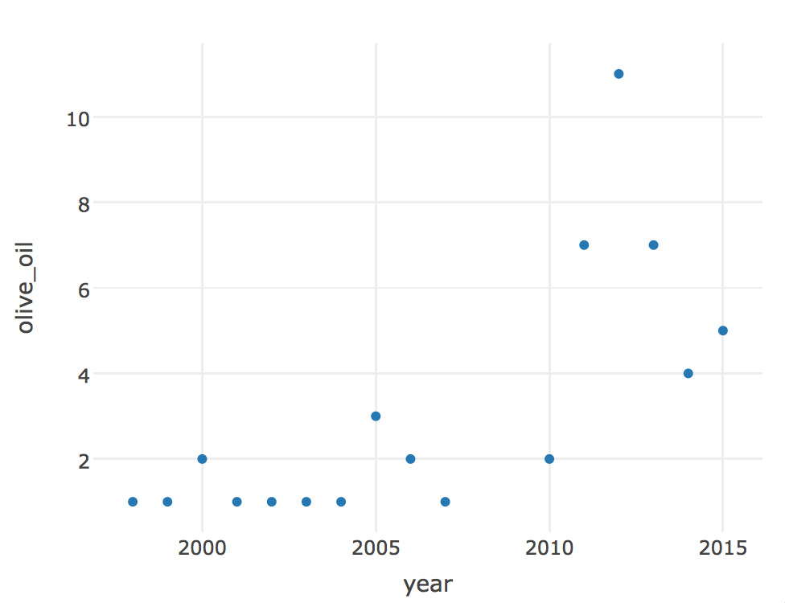
Increase of olive oil ingredient frequency

Slide 12
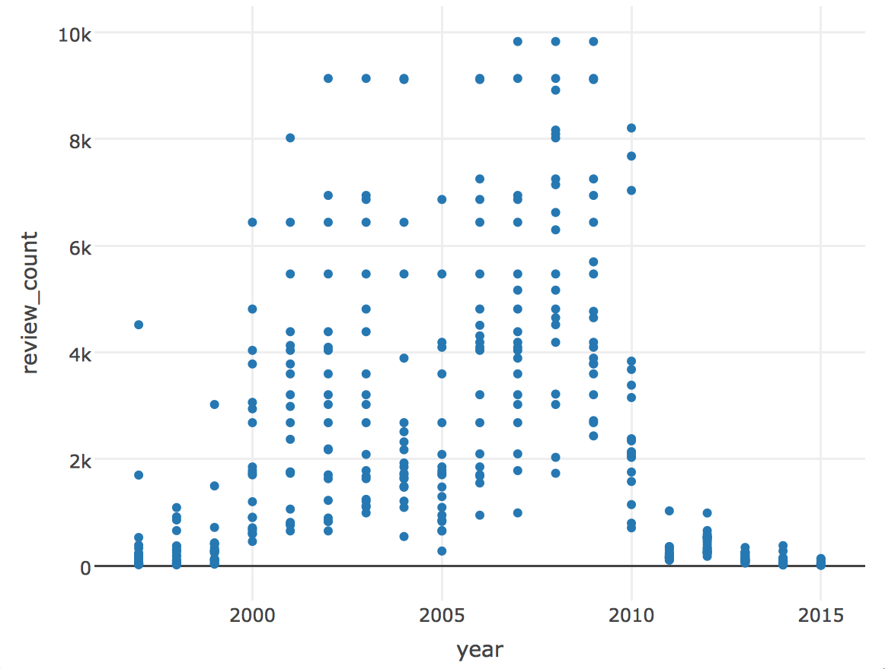
The need for allrecipes to innovate
Review count

Slide 13
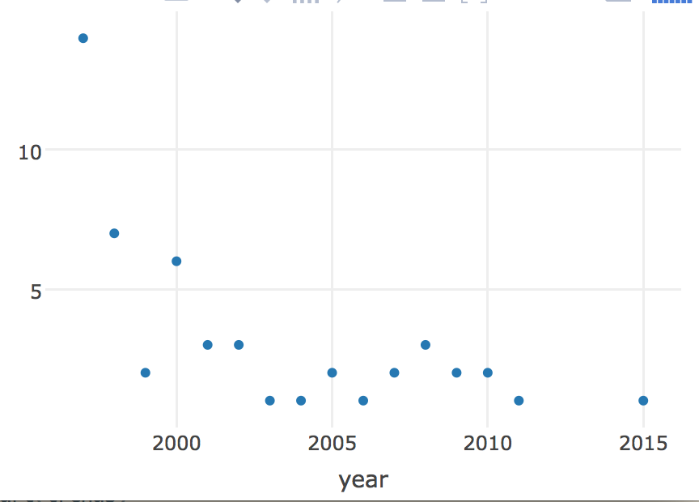
The cookie trail
In 1997, cookie exchanges were very popular.
Further research indicates that allrecipes started as Cookiereceipt.com. All 20 recipes in 1997 were cookie related….the need for domain knowledge!
Notes:
The founder had 38 different recipes before he realized he should combine them.

Slide 14
Conclusions
Scraping was successful.
The trends I was hoping to find were not necessarily present in the top 20 recipe list.
Perhaps present in ingredients list.
Determined trends in popular recipes and ingredients in popular recipes.
Audience…
Notes:
Ask people about their favorite recipe

Slide 15
Most popular recipes
‘Clone of cinnabon’ from years 2001-2009
‘Jamie's cranberry spinach salad’ years 2000-2009
Dark ages of cooking…

